Slide 1
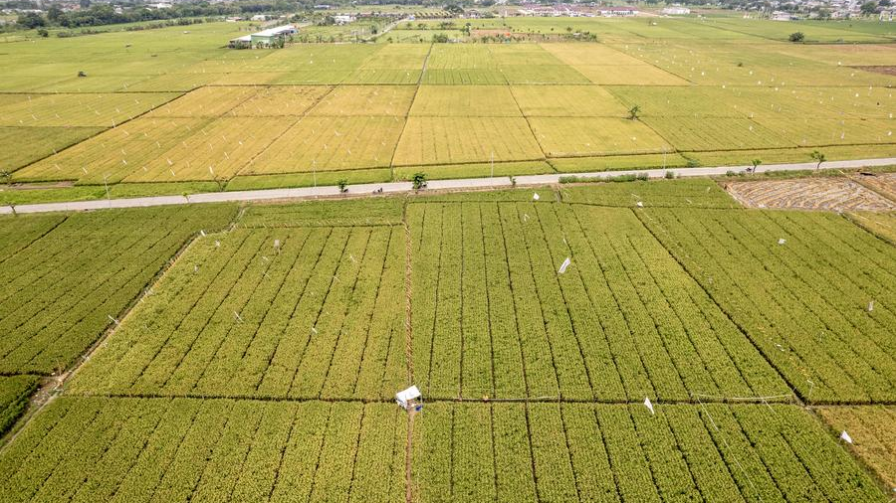
CIRDAP COMPETITION 2026
GreenLoop 3.0
Circular Agriculture for Rural Empowerment
An Efficiency-by-Design Architecture Transforming Asia-Pacific Agriculture Through 4IR Technologies
Technical Master Proposal
15
3.0
$72
March 2026
Member Countries
Architecture Layers
Income Boost/Acre

Slide 2
STRATEGIC CONTEXT
The High-Use Paradox: A Systemic Crisis
Regional agriculture faces a critical paradox: While nitrogen fertilizer intensification historically ensured food sovereignty, the legacy model has reached systemic saturation. Nutrient Use Efficiency (NUE) has collapsed significantly, creating a dangerous decoupling of input from productivity.
Water Inefficiency Crisis
78%
of Boro rice irrigation water is used inefficiently
This represents massive resource waste in a region where water scarcity is intensifying due to climate change.
61%→50%
50%→42%
China NUE Decline
India NUE Decline
$8B
Inorganic Value Leaks
Annual Fiscal Drain (India)
Ghost beneficiaries and subsidy diversion account for 6-20% of total sales value , undermining fiscal governance and farmer trust.
The economic burden of inefficient input-heavy models demands urgent architectural intervention.

Slide 3
SOLUTION OVERVIEW
GreenLoop 3.0: Efficiency-by-Design Architecture
A three-layer integrated system targeting the 3.5% efficiency gain potential inherent in digital transformation
LAYER A
LAYER B
LAYER C
Physical
Digital
Intelligence
Hardware-driven precision restoring soil health and mitigating environmental externalities through low-latency data loops.
Transitioning from fragmented data silos to "Data Sovereignty" and immutable transparency through blockchain governance.
Converting raw data into actionable knowledge for low-literacy environments through Participatory MEL framework.
12-Parameter Sensor
Hybrid Data Strategy
AI Advisory Interface
3F4D+MD Irrigation
Hyperledger Fabric
NEET Youth Network
Solar Cold Chain
5-Point Security
4A Learning System
Legacy Models vs. GreenLoop 3.0
Input-Heavy Legacy Models
GreenLoop 3.0 Efficiency-by-Design
•
Declining NUE (China: 50%, India: 42%)
Optimized precision via 12-parameter sensing & ML
•
78% irrigation water inefficiency
57% water reduction via precision 3F4D+MD irrigation
•
6-20% value leaks from diversion
Zero-leakage via POS-triggered e-Bill & SHA-256
•
Massive subsidy drain (>$8B India)
Immutable audit trails on Hyperledger Fabric
•
One-way "broadcast" knowledge model
Two-way "Learning System" with farmer knowledge production

Slide 4
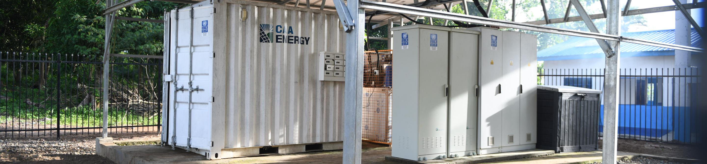
LAYER A: PHYSICAL ARCHITECTURE
Precision Hardware for Circular Farming
12-Parameter Soil Sensor
ML-enabled handheld sensor analyzing 12 critical parameters : pH, EC, NPK, Ca, Mg, S, Fe, Zn, Mn, B, SOM, and Redox Potential —critical for ML estimation of micronutrient bioavailability.
Solar Cold Chain
20-32%
30%
10-ton solar-grid hybrid units operating at 2°C-8°C stop 25-40% post-harvest value destruction with 70% lower operating costs.
Yield Increase
Profitability Boost
CO₂ Sequestration
3,500kg/unit/year
IRR
14.47%
3F4D+MD Irrigation Protocol
Investment Status
PPP-Ready
"Three-Phase Four-Day + Modified Depth" creates specific aerobic soil conditions facilitating Iron Oxide re-precipitation for arsenic immobilization.
Key Innovation
57%
9-21%
Water Conservation
Arsenic Reduction
The Redox Potential parameter enables ML-based prediction of micronutrient bioavailability, transforming blanket fertilization into site-specific precision agriculture.

Slide 5
LAYER B: DIGITAL ARCHITECTURE
Blockchain Governance & Data Sovereignty
Transitioning from fragmented data silos to immutable transparency
The 5-Point Security Framework
Hybrid Data Strategy
1
Smart Farmer Card
NID-linked identity storing soil health rating and financial credit score, creating a unified farmer digital profile.
PostgreSQL (Off-chain)
"Source of Truth for Details" —Manages high-throughput PII and soil records with low-latency processing while ensuring data privacy compliance.
2
e-Bill System
POS-triggered disbursement where subsidies are only triggered upon verified agricultural sales, eliminating diversion to industrial sectors.
Hyperledger Fabric (On-chain)
"Source of Truth for Integrity" — Proof of Authority (PoA) consensus for energy-efficient rural nodes.
3
Hyperledger Fabric
Immutable ledger for subsidy claims ensuring inter-agency interoperability and transparent governance.
4
PostgreSQL
Handles high-volume transaction histories and granular field data for real-time advisory services.
Security Architecture
5
SHA-256 Hashing
SHA-256 hashing ensures every transaction is hash-linked. Only the hash is stored on-chain, preserving record integrity while keeping detailed PII secure off-chain.
Every transaction is hash-linked with only the hash stored on-chain, ensuring record integrity while protecting PII.

Slide 6
LAYER C: INTELLIGENCE ARCHITECTURE
AI Advisory & Human Capital Development
Converting raw data into actionable knowledge for low-literacy environments
AI Advisory Interface
The 4A Learning System
Icon-driven, Bengali voice-controlled UI bridges the digital divide, enabling 80% information society penetration even in low-literacy rural communities.
A1
Access
Voice-driven, low-bandwidth entry points ensure universal accessibility regardless of literacy or connectivity.
80%
Information Penetration
A2
Action
Mandatory feedback prompts after each transaction close the learning loop and validate advisory effectiveness.
NEET Youth Facilitator Network
A3
Analysis
AI-human collaborative verification within a 24-hour window ensures data quality and actionable insights.
Mobilizing 200+ "Not in Education, Employment, or Training" youth as Digital Facilitators managing Agro-Service Centres (ASCs).
Human-in-the-loop interface: Youth facilitators serve as the critical bridge between technology and farmers, providing localized support and feedback.
A4
Adaptation
Rapid policy shifts driven by FRRP and VRRP scoring enable dynamic, evidence-based program evolution.
Resilience Recognition (FRRP/VRRP)
Success measured by Family Resilience Recognition (FRRP) score reflecting climate-smart practice mastery and economic stability.
Gold Resilient Household
80+

Slide 7
IMPACT ASSESSMENT
FAO "Four Betters" Framework & SDG Alignment
Mapping GreenLoop 3.0 interventions to global development goals
Better Production
Better Environment
SDG 2
Zero Hunger
SDG 6 & 13
Clean Water & Climate Action
Interventions: 12-parameter sensor; STFFT implementation
Interventions: Solar cold chain; 57% water savings
20-32%
90%
3,500kg
57%
Yield Increase
STFFT Coverage
CO₂/Unit/Year
Water Savings
Better Nutrition
Better Life
SDG 2 & 3
Zero Hunger & Good Health
SDG 1 & 5
No Poverty & Gender Equality
Interventions: Digital Family Cards; 3F4D+MD irrigation
Interventions: NEET youth network; NID-linked credit; Gender-responsive design
9-21%
12K Cr
Annual Income Boost
$72/acre
Arsenic Reduction
BDT Safety Fund
$20 subsidy protection
$30 market access
$16 financial inclusion
$6 carbon credits
Gender-responsive: 18+ female head of household required for Digital Family Card registration

Slide 8
FINANCIAL VIABILITY
Investment Readiness & Economic Returns
Scalable unit-cost model designed for regional institutionalization
Pilot Budget Overview
Solar Cold Chain: PPP-Ready
Total Pilot Budget
$92,625
Internal Rate of Return
14.47%
Attractive returns for private sector investment
500
$185
Farmers Enrolled
Unit Cost/Farmer
70%
3,500kg
Cost Reduction
CO₂/Unit/Year
Benefit-Cost Analysis
Income Boost Breakdown ($72/acre)
Benefit-Cost Ratio
>3.0
1
Subsidy Protection
$20
Every dollar invested generates over $3 in economic returns
2
Market Access
$30
Direct Income Boost
$72/acre/year
3
Financial Inclusion
$16
Yield Increase Value
20-32%
4
Carbon Credits
$6
Profitability Boost
30%

Slide 9
IMPLEMENTATION ROADMAP
Scaling Strategy: 2026-2030
Phased approach for regional institutionalization across CIRDAP member countries
Y1
Pilot Phase
Y3
National Scale-up
Y5
Vision 2030
2026
2028
2030
500 Farmers
30 AEZs
Ag-Data Commons
Direct enrollment and training
Agro-Ecological Zone coverage expansion
National platform institutionalization
50 Facilitators
Regional Nodes
Smart Agri-Towns
NEET youth network activation
Hyperledger Fabric node activation
Tech-enabled rural transformation hubs
100 Sensors
Training Scale
15 Countries
12-parameter soil analysis deployment
Institutional capacity building programs
CIRDAP member country coverage
e-Bill Terminals
PPP Expansion
Sustainability
NID-linked subsidy verification
Private sector partnership mobilization
Self-sustaining circular ecosystem
Scaling Trajectory
500
30K+
500K+
From 500 farmers to regional transformation across 15 CIRDAP member countries
Year 1
Year 3
Year 5

Slide 10
STRATEGIC ALIGNMENT
Alignment with CIRDAP Priorities
GreenLoop 3.0 directly supports CIRDAP's 2025-26 strategic focus areas
Climate-Resilient Food Security
Youth Engagement
CIRDAP's priority on climate-resilient food security and safety aligns with GreenLoop's 3F4D+MD irrigation, solar cold chain, and carbon sequestration.
CIRDAP's youth-focused initiatives align with the NEET Youth Facilitator Network creating employment for 200+ rural youth.
57% water savings
3,500kg CO₂/unit
200+ facilitators
Digital skills
Digital Rural Development
World Rural Development Day
CIRDAP's AI integration and digital innovation focus matches GreenLoop's AI advisory, blockchain governance, and Knowledge Circuit potential.
GreenLoop embodies the WRDD vision of integrated, inclusive, sustainable and enterprising rural development .
80% penetration
Voice UI
UN-recognized July 6 celebration aligns with GreenLoop's participatory approach
Gender-Responsive Programming
Rural Innovation Challenge 2026
CIRDAP's gender mainstreaming priority is operationalized through the 18+ female head requirement for Digital Family Card registration.
GreenLoop 3.0 meets all criteria for the CIRDAP-REEDS Rural Innovation Challenge :
✓ Scalable solution
✓ Measurable impact
Female empowerment
Financial inclusion
✓ Regional relevance
✓ Innovation focus

Slide 11
PARADIGM TRANSFORMATION
From Prescriptive Agriculture to Analytical Agro-Ecology
The Old Paradigm
The GreenLoop Paradigm
Farmers as Consumers
Farmers as Producers of Knowledge
Passive recipients of one-way "broadcast" advice with no feedback mechanism or knowledge contribution.
Active participants in the 4A Learning System, contributing feedback that drives AI-human collaborative analysis and policy adaptation.
Blanket Prescriptions
Site-Specific Precision
Uniform recommendations ignoring site-specific soil conditions, leading to over-application and inefficiency.
12-parameter sensing with ML-based Redox Potential analysis enabling tailored prescriptions for optimal nutrient bioavailability.
Time-Bound Projects
Circular Feedback Loop
Interventions ending when funding ceases, leaving no sustainable infrastructure or institutional memory.
Self-sustaining ecosystem where rural development becomes a tech-enabled movement rather than a time-bound project.
Result: Systemic value leaks, declining efficiency, and farmer dependency on external inputs.
Result: Sustainable transformation where farmers are architects of their own prosperity.
The Circular Loop
3.5%
4IR technologies + Participatory Action Research = Sustainable rural empowerment
Efficiency Gain Potential

Slide 12

CIRDAP COMPETITION 2026
Building the Circular Frontier Together
GreenLoop 3.0 invites CIRDAP member countries to co-create a future where rural communities are not just beneficiaries but architects of their own prosperity.
20-32%
$72
15
2030
Yield Increase
Income Boost/Acre
Member Countries
Vision Target
Together, we scale the circular frontier—transforming farmers from passive consumers of advice into sophisticated producers of knowledge.
GreenLoop 3.0 | Circular Agriculture for Rural Empowerment

